Slide 1
Mackenzie US TIPS index ETF (CAD HEDGED) (QTIP)
October 2019

Slide 2
economic indicators that inform our outlook for inflation linked bonds

Slide 3
Remaining on Different Growth Paths
Index Level
US GDP growth is near 2% but the ISM-Manufacturing Index is now below 50 (meaning that manufacturing activity is no longer increasing). Trade concerns are impacting exports and cap-ex. During this expansionary cycle, the ISM-Manu Index has fallen below 50 several times
ISM Non-Manufacturing which measures the level of “service” activity remains stronger. The current level historically has been association with GDP growth closer to 3%
Source: Bloomberg NAPMPMI Index and NAPMNMI Index, monthly data, ending August 31, 2019

Slide 4
US Economy is Surprising to the Upside
US Economic Surprise Indicator has turned higher, being helped by falling yields
Index Level
Yield %
The CESI (economic surprise index) has rebounded strongly as durable goods orders, housing, employment, wage gains have beat expectations
The gap between the surprise index and US10s narrowed and crossed. The massive drop in yields across the curve since November are now supportive of economic activity. We argue that the US (and other countries) should have a similar interest rate sensitivity to falling interest rates as they did to rising interest rates
Source: Bloomberg, CESIUSD Index and USGG10YR Index weekly data to September 27, 2019

Slide 5
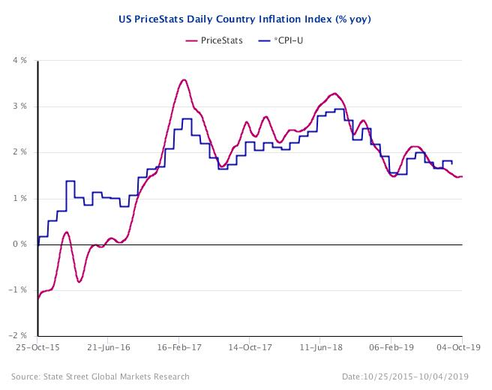
US Inflation Headline vs Daily Inflation
PriceStats (daily inflation) is indicating slower inflation in the short term. Oil/gasoline prices are currently lower than the same time last year which means the base effect still has a negative impact on the YoY inflation. This is likely to change in the next few months. The risk of a more severe growth slowdown is weighing on breakevens
A counter balance is the notion that Central Banks will “do whatever it takes” to maintain global growth. Further, governments (especially in Europe) appear ready to consider fiscal spending increases as monetary policy alone has not provided sufficient stimulus.
Source: State Street Global Markets Research, 09/24/2015 to 09/03/2019

Slide 6
Wages Growth supports higher inflation
Annual Wage Growth has Exceeded 3% Since 1Q18
% Growth in Wages
This chart shows the upward pressure on US inflation being exerted by solid wage gains even though it has yet to be reflected in headline inflation at 1.7% (core inflation is 2.4%)
Wage data improvement is broad based but shows that after years of lagging, wage growth in non-supervisory roles is now increasing faster than for those in management positions
Bloomberg: Atlanta Fed Wage Tracker Median Wage Growth, monthly ending 08/30/2019

Slide 7
Global backdrop
Index Level
Yield %
Weaker but still decent global growth – this could be just another “soft patch”
G10 data change weakened considerably and this is in part due to the strength of the data last year
US 10 year bonds already reflect this ‘reality’ – where do we go from here is the question. Recession versus soft patch?
Source: Bloomberg CECIDG10 Index and USGG10YR Index, daily from May 1, 2013 to October 3, 2019

Slide 8
US Break-evens
Breakeven rates of inflation %
Implied inflation expectations have declined, so have implied growth expectation – questionable how much real economic information markets can take out of implied prices
Symmetry of the FED’s mandate is now dovish for both rates and the balance sheet
In our opinion, TIPS are still priced cheaply to UST of a similar term based on historical data
Source: Bloomberg weekly data, generic government 5Yr, 10Yr and 30YR break-evens ending September 27, 2019

Slide 9
2H2019 TIPS Outlook
TIPS generated a strong positive return during the first three quarters of 2019, albeit underperforming nominal bonds. Up until April, ILBs were stellar outperformers, but breakevens have retreated recently giving back gains above and beyond what was gained.
Inflation, or lack there of has been in the news recently. While we agree that inflationary pressures have receded slightly, we do not buy into the disinflationary argument. Measuring inflation is always a time period approximation. The most traditional ways to estimate inflation is on a year-over-year (YoY) or month-over-month (MoM) basis. The YoY time series has declined markedly in recent months – much of that, if not most, has to do with the starting point of the measurement period and not the end. This time last year we had oil prices of >$70 per barrel, we are currently <55$; that exerts downward pressure on YoY inflation rates. A lot depends on the window one looks at for inflation – we believe the peak of negative (YoY) inflation releases will be seen in the next month. We believe underlying inflation has broadly stayed at around 2-2.25% with upward pressures from wages still around. US core inflation is at 10-year highs!
While a few different factors can cause a rise in the general price level, wage inflation has often been the culprit of longer-lasting inflation cycles. The wage-price spiral of rising wages leading to higher prices and therefore influencing wages upwards again is well-documented. The structural decline of unions as well as technological advancements make us believe that there is no imminent risk of tipping into a massive inflationary regime – but on balance we see some upward pressure stemming from higher wages. Those wage pressures appear broad based spanning across many different indicators (Employment Cost Index, Average Hourly Earnings, Atlanta Fed Wage Index, Compensation Intentions, etc.). Moreover, the Fed’s pivot from hawkish to dovish poses some upward potential for TIPS as well. We believe that a central bank, which is prepared to stay on the sidelines while the economy regains its strength and will also allow it to run a bit hot, is also likely inclined to support higher expected inflation rates. The cover of lower temporary inflation (via the oil-price decline) masks the underlying strength of wages in a generally solid economy. This allows the Fed to remain dovish for longer and let inflationary pressures build.
TIPS are a liquid asset class, but remain highly sensitive to a changing macro picture. It is our belief that we will only get higher rates (short term policy & longer term) if we get some significant impulse from the inflation side. While this is positive for TIPS on a relative basis vs. nominal bonds, in absolute terms this might not be overly beneficial given the large duration on TIPS. But, with the Fed apparently on hold over the near term, there appears to be a window to be outright long TIPS before engaging in more duration-hedging strategies later this year.
Outlook date: September 30, 2019

Slide 10
When To Use Inflation Linked Bonds - Key Determinates are Growth and Inflation
Our current view:
A tight labor market and wage growth of over 3% is supportive of inflation rates that could be higher than the market is currently expecting
The US economy is poised to grow albeit at a slower pace than in 2018 (approx. 2% for 2019)
The Fed’s efforts to extend this business cycle by lowering interest rates and expressing a tolerance for higher inflation are supportive of inflation linked bonds
The outlook for TIPS remains constructive & supports including TIPS as part of a diversified fixed income portfolio
Outlook date: September 30, 2019

Slide 11
Why QTIP?

Slide 12
Why QTIP?
Key reasons | Insights
Good price | Management fee 15 bps
No competitor | Only Canadian based ETF offering a pure play on US TIPS
No currency risk | 100% hedged back to CAD
No withholding tax | QTIP is a Canadian domiciled products and therefore is not subject to withholding tax - a significant advantage over ILB ETFs offered by US domiciled companies
No term constraint | QTIP is a passive product that has exposure across most/all maturities
Good liquidity | Underlying liquidity of the TIPS market
Open for business | Please reach out to a Mackenzie ETF Specialist to assist in large trades
Source: Mackenzie Investments, September 30, 2019

Slide 13
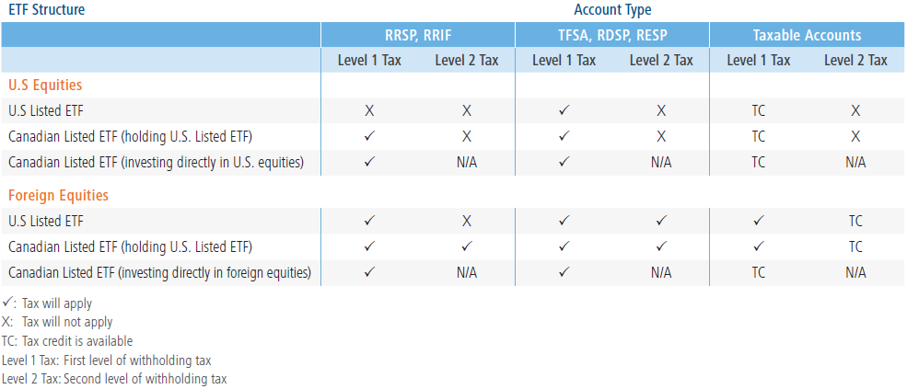
ETF Domicile Matters
Accessing US-domiciled ETFs is relatively easy and can often come with very low expense ratios and high levels of secondary market liquidity. However, there are meaningful tax and currency considerations for both investors and asset managers alike.
US Withholding tax
Certain types of debt within emerging markets are subject to withholding taxes that look more like tax on equity distributions versus tax on fixed income distributions.
US Estate tax
US estate tax can arise on the death of a Canadian taxpayer who owns property that is connected to the US at time of death.
The withholding tax will be applied first by the country where the bond originates from. After the first level of withholding tax, the US applies an additional withholding tax on distributions made by the US ETF to the Canadian taxpayer (as the distribution is not seen as income; rather it is seen as a dividend made from an equity security).
This is based on the fair market value of the assets at that time. US Estate tax applies to individuals who own assets tied to the US valued at more than $60,000 USD and have a worldwide estate exceeding $11,200,000 USD at the time of death.
By investing in Canadian-domiciled ETFs, investors can gain exposure to US markets without holding shares of a US-domiciled ETF thus ensuring that US federal estate tax is not triggered on death.
Source: Mackenzie Investments

Slide 14
Domicile Matters: Why Buying a Canadian Listed ETF Could be a Better Choice
Buying a US-listed ETF
Buying a Canadian-listed ETF
The ETF receives interest payments from TIPs held
The ETF receives interest payments from TIPs held
US-listed ETF invested in TIPs
Canadian-listed ETF invested in TIPs
The Canadian investor receives a monthly distribution from the ETF after withholding tax held by US (Level 1)
The Canadian investor receives a monthly distribution from the ETF
Tax withheld may be recovered by Canadian investors with certain account types
There is no level 1 tax
Canadian investor
Est. 0.30% impact
Canadian investor
Source: Mackenzie Investments

Slide 15
QTIP: Mackenzie US TIPS Index ETF (CAD-Hedged) Portfolio Characteristics
Duration Breakdown
 | ETF Portfolio
Average credit quality | AAA
Duration | 7.8 years
Portfolio Yield | 0.32%
AUM | $399 MN
Inception date | Jan 2018
Management fee | 15 bps*
15
Source : Mackenzie Investments as of September 30, 2019. *Management fee reduction effective September 20, 2019

Slide 16
Performance: Growth of $10K Since Inception
 | 3 Mon | 6 Mon | YTD | 1 YEAR | Since Incept
QTIP | 1.2% | 3.8% | 6.8% | 6.0% | 3.0%
Solactive UST Inflation-Linked Bond Hgd CAD | 1.4% | 4.1% | 7.2% | 6.5% | 3.4%
Source: Mackenzie Investments, index and Fund returns are hedged to CAD. From common inception (January 2018) to 08/30/2019

Slide 17
appendix

Slide 18
TIPs in Action Compared to “Nominal” Bond Heavy Indices
Duration assets performed well as Central Banks were expected to remain on hold. QE plans were announced and actioned. Expectations were that inflation would rise
Bernanke in mid-2013 suggested tapering QE. The market’s interpretation was that interest rates were poised to rise from zero. Duration assets did poorly, the drop in inflation was another blow to TIPS
Source: Morningstar Direct. Calendar year returns based on monthly data. All returns are in local currencies. As of August 31, 2019

Slide 19
Dedicated execution and trade facilitation support
The ETF Portfolio Operations team at Mackenzie Investments has an average of 13 years of experience in ETF market making from both the ETF issuer and the market maker’s perspective. The Mackenzie ETF team also includes 3 regional ETF specialists who liaise with wholesalers and advisors as well as the ETF Portfolio Operations team.
Providing market feedback
Assisting with complex trades
Facilitating custom baskets

Slide 20
Providing Market Feedback
Market volatility: In times of market volatility there is a widening in ETF bid/ask spreads. Premiums or discounts of the ETF’s market price relative to NAV may also occur. Seeking trading assistance and using limit orders may be advisable.
Market open/close times: International markets may be closed when North America is open for trading. When those markets are closed information continues to flow that may affect the security prices which contribute to the ETF price. It is the responsibility of the market makers to make adjustments to the ETF price during North American trading hours to reflect the new information.
Trade size: When looking to place large trades of an ETF, it may be best to contact the brokerage platform or Mackenzie for assistance.
Providing market feedback
Assisting with complex trades
Facilitating custom baskets

Slide 21
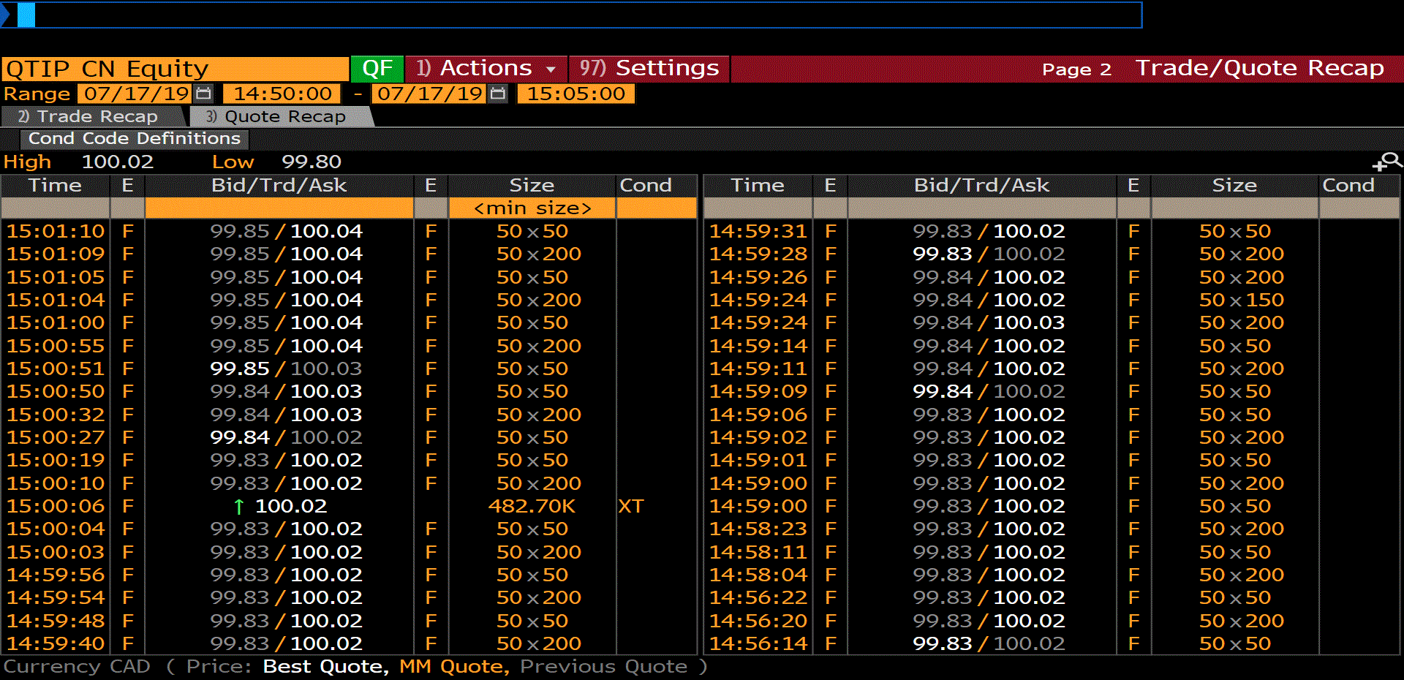
Trading & Liquidity: Large AUM ≠ Better pricing
Mackenzie US TIPS Index ETF (CAD-Hedged) (QTIP) AUM at start of trading day: $213 million
Block trade at 15:00:06: $48.3 million (representing 23% of AUM)
No impact to ETF price from pre- to post-trade
A higher NAV (approx. $100) means less shares to be traded to achieve the desired exposure, thereby reducing commission-related costs relative to ETFs with lower NAV.
Providing market feedback
Assisting with complex trades
Facilitating custom baskets
Source: Bloomberg, Mackenzie Investments

Slide 22
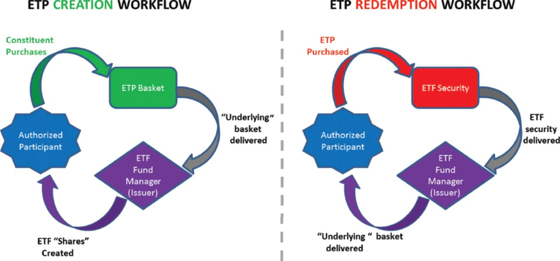
Custom basket process
Opportunity:
Transitioning single line bond holdings to Mackenzie ETFs
Providing market feedback
Assisting with complex trades
Facilitating custom baskets
Source: Mackenzie Investments, as of September 30, 2019.

Slide 23
Disclaimer
FOR ADVISOR USE ONLY. No portion of this communication may be reproduced or distributed to the public as it does not comply with investor sales communication rules. Mackenzie disclaims any responsibility for any advisor sharing this with investors.
Commissions, trailing commissions, management fees, and expenses all may be associated with mutual fund investments. Please read the prospectus before investing.
Index performance does not include the impact of fees, commissions, and expenses that would be payable by investors in the investment products that seek to track an index.
The Mackenzie ETFs are not sponsored, promoted, sold or supported in any other manner by Solactive nor does Solactive offer any express or implicit guarantee or assurance either with regard to the results of using the Indices, trade marks and/or the price of an Index at any time or in any other respect. The Solactive Indices are calculated and published by Solactive. Solactive uses its best efforts to ensure that the Indices are calculated correctly. Irrespective of its obligations towards the Mackenzie ETFs, Solactive has no obligation to point out errors in the Indices to third parties including but not limited to investors and/or financial intermediaries of the Mackenzie ETFs. Neither publication of the Solactive Indices by Solactive nor the licensing of the Indices or related trade mark(s) for the purpose of use in connection with the Mackenzie ETFs constitutes a recommendation by Solactive to invest capital in said Mackenzie ETFs nor does it in any way represent an assurance or opinion of Solactive with regard to any investment in these Mackenzie ETFs.
Mutual funds and ETFs are not guaranteed, their values change frequently and past performance may not be repeated.
The content of this document (including facts, views, opinions, recommendations, descriptions of or references to, products or securities) is not to be used or construed as investment advice, as an offer to sell or the solicitation of an offer to buy, or an endorsement, recommendation or sponsorship of any entity or security cited. Although we endeavour to ensure its accuracy and completeness, we assume no responsibility for any reliance upon it.
This should not be construed to be legal or tax advice, as each client’s situation is different. Please consult your own legal and tax advisor.
This document may contain forward-looking information which reflect our or third party current expectations or forecasts of future events. Forward-looking information is inherently subject to, among other things, risks, uncertainties and assumptions that could cause actual results to differ materially from those expressed herein. These risks, uncertainties and assumptions include, without limitation, general economic, political and market factors, interest and foreign exchange rates, the volatility of equity and capital markets, business competition, technological change, changes in government regulations, changes in tax laws, unexpected judicial or regulatory proceedings and catastrophic events. Please consider these and other factors carefully and not place undue reliance on forward-looking information. The forward-looking information contained herein is current only as of [insert date]. There should be no expectation that such information will in all circumstances be updated, supplemented or revised whether as a result of new information, changing circumstances, future events or otherwise.

